Slide 1
Airbnb Toronto:
Performance Snapshot
Period: July 2024 – July 2025
By Yosias Teshome
Date
Strategy Insights

Slide 2

Objective
Framing the performance story
Analyze how:
🏠 Rental scope
📍 Location
🏢 Property type
⏱️ Stay duration and
👥 Guest capacity
shape Airbnb performance across Toronto.

Slide 3
Market Statistics
Snapshot of supply, scope, and performance drivers
Active listings: 11,177
Top-performing scope: Entire
Average Revenue: $24,036
Average Occupancy: 136 days
Top-performing location: Downtown Core
Downtown Entire listings lead revenue

Slide 4
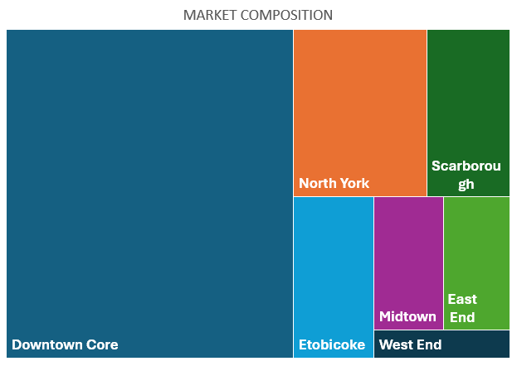
Market Composition
Where listings are concentrated
Downtown Core dominates supply and performance
Listings: 6381 (57.1%)
North York is 2nd in Supply
Listings: 1506 (13.5%)
Scarborough and Etobicoke
have just under 1000 listings.

Slide 5



Rental Scope
Performance by listing type (Entire, Private, Shared)
Entire rentals dominate revenue across all segments
Private rooms show strong occupancy, especially in budget-friendly areas
Shared rooms: niche
  16 listings, ~$5K/year
  87 days occupancy
Notes:
Entire
- Whole property, full privacy
2. Private room
Own bedroom
Shared common areas
3. Shared room
Shared bedroom and common areas

Slide 6
Neighbourhoods
Downtown leads in both revenue and occupancy
Downtown Core dominates across all scopes
  Entire properties earn most ($33,682)
  Private rooms show highest occupancy
  (152 days)
Dividing a property into multiple private room listings can outperform a single entire rental in some cases.
Notes:
Highlight or bolden, maybe put in box

Slide 7
Property Type
Villas and niche property types skew revenue high
  But make up <1% of listings
Entire apartments offer best balance of revenue and occupancy
  49% of listings, strong occupancy
Entire houses underperform despite large share
  20% of listings, lowest demand

Slide 8
Stay Durations
Short-term, Long-term, Seasonal and Lease-style
Lease-style & seasonal lead in occupancy due to longer stays and consistent demand
Short-term is revenue competitive despite lower occupancy, driven by higher nightly rates
Longer stays drive occupancy; short-term stays rely on pricing power
Notes:
Short-term (<28 days), classic listings
Long-term (28-89 days), monthly renters (possibly due to regulations)
Seasonal (90 -179 days),
Lease-style (180+ days)

Slide 9
Guest Capacity
Performance by guest capacity and rental scope
Group-sized Entire listings earn the most
  Driven by higher nightly rates and multi-guest bookings
Private rooms perform steadily in Small and Medium categories
  Strong budget appeal and consistent fill rates
Occupancy is higher and tighter across mid‑range categories

Slide 10
Strategic Insights: What drives Performance?
Scope, Capacity and Duration
Scope sets the baseline 🏠
  Entire listings dominate revenue; Private rooms drive occupancy
Capacity scales opportunity 👥
  Group-sized listings earn more; mid-range fills faster
Duration shapes demand 📅
  Lease-style leads occupancy; short-term holds pricing power
Performance is multi-factorial — but these three levers drive the biggest shifts

Slide 11
Deep Dive
Duration:
Capacity:
Scope:

Slide 12
Deep Dive
Key Patterns from Segment Intersections
Entire Group-sized listings dominate revenue 👥💰
  Multi-guest bookings and premium pricing drive top-line performance
Entire Lease-style listings lead occupancy 🛏️📈
  Large and Medium both hit 255 days
  Consistent occupancy from longer stays and stable tenants
Short-term Group listings remain competitive ⏱️💵
  Occupancy is lower (~105 days)
  Still strong revenue due to higher nightly rates
Segment strategy matters 🔀
  High revenue ≠ high occupancy
  Optimizing listing performance requires aligning scope, size, and duration

Slide 13
Closing Insight: Strategic Alignment Wins
Performance is alignment: Scope × Capacity × Duration
🏠 👥 ⏱️
Optimize your listings by aligning scope, capacity, and duration with local demand!
Notes:
Mid-range capacity is occupancy sweet spot
Small and Medium Entire listings fill consistently
Group Entire listings dominate revenue
Especially in short-term and seasonal formats

